Slide 1

OBJECT ORIENTED MODELLING & DESIGN (OOMD)
Advanced Algorithm
Surabhi Narayan
Nithin H A
N S Kumar
Department of Computer Science

Slide 2
ADVANCED ALGORITHMS Pre-requisites
Design and Analysis of Algorithms
Design Framework
Algorithms Design Strategies
Divide and Conquer
Decrease and Conquer
Transform and Conquer
Greedy Technique
Dynamic Programming
Back Tracking and Branch and Bound
Analysis Framework

Slide 3
ADVANCED ALGORITHMS Syllabus
Analysis of Recurrence using substitution, tree
and master methods
Asymptotic and Amortized complexity
NP and reduction
String Matching Algorithms
Pattern pre-processing
Text pre-processing
Graph Theoretic problems – maxflow and mincut
Polynomial Representation & efficient multiplication

Slide 4
ADVANCED ALGORITHMS Syllabus
Number Theory
Prime Factorization
Chinese Theorem
Encryption
Dynamic Programming
Randomized Algorithm
Approximate Algorithm

Slide 5
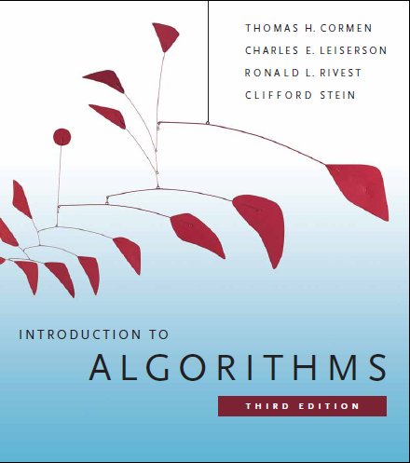
ADVANCED ALGORITHMS Text Book and Reference Books
Text Book:
“Introduction to Algorithms”, T H Cormen, C E Leiserson, R L Rivest and C Stein, 3rd Edition, PHI, 2010
Reference Books:
”The Algorithm Manual”, Steven Skiena, 2nd Edition, Springer Publication
“Randomized Algorithms”, R Motwani and P Raghavan, Cambridge University Press, 2011

Slide 6
ADVANCED ALGORITHMS A few more points
Why this course?
Learn Algorithms fairly complez
Analyze Algorithms differently
Get Exposed to different domains
Improve Thinking
Assessment ?

Slide 7
ADVANCED ALGORITHMS Introduction
What is an algorithm?
Step by step way of solving problem
0 or more inputs
1 or more outputs
Definite
Finite
Effective

Slide 8
ADVANCED ALGORITHMS Introduction
Different Algorithms to solve the same problem
Same technique to solve different kinds of problems
What aspects to consider?
Correctness
Can an incorrect algorithm be useful?
Can an approximate result be useful?
Efficiency with respect to time
Efficiency with respect to space

Slide 9
ADVANCED ALGORITHMS Analysis Framework
Algorithm Analysis: Predicting the resources
that the algorithm requires
Two types of Resources:
Time
Space
Factors contributing to Algorithm Analysis Framework
Input Size
Units for measuring run time
Order of Growth
Worst-Case, Best-Case and Average-Case Efficiencies

Slide 10
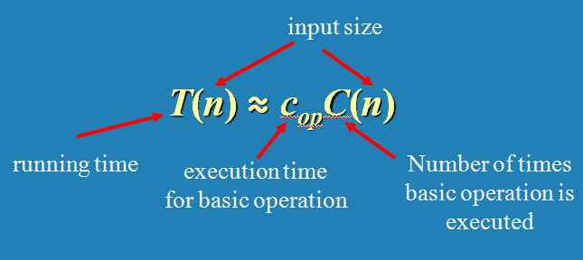
ADVANCED ALGORITHMS BASICS OF COMPLEXITY
Time Efficiency
Counting the number of times the algorithm’s basic operation is executed on inputs of size n

Slide 11
ADVANCED ALGORITHMS BASICS OF COMPLEXITY
Mathematical Analysis of Iterative Algorithms
Find the input size
Identify the basic operation
Count the # of operations by summation
Binary search on linked list?

Slide 12
ADVANCED ALGORITHMS Counting : Some Examples
c <- 0
for i <- 1 to n do
c <- c + 1
----------------
c <- 0
for i <- 1 to n do
c <- c + i

Slide 13
ADVANCED ALGORITHMS Counting : Some Examples
c <- 0
for i <- 1 to n do
c <- c + i * i
----------------
c <- 0
for i <- 1 to n do
c <- c + 1
for j <- 1 to n do
c <- c + 1

Slide 14
ADVANCED ALGORITHMS Counting : Some Examples
c <- 0
for i <- 1 to n do
for j <- 1 to n do
c <- c + 1
----------------
c <- 0
for i <- 1 to n do
for j <- i + 1 to n do
c <- c + 1

Slide 15
ADVANCED ALGORITHMS Counting : Some Examples
c <- 0
for (i <- n; i > 0; i <- floor(i / 2))
c <- c + 1
----------------
c <- 0
for (i <- n; i > 0; i <- floor(i / 2))
for j <- 1 to i do
c <- c + 1

Slide 16
ADVANCED ALGORITHMS Counting : Some Examples
k ← 0
n ← length(str)
for each permutation of str
j ← 1
while (j ≤ n)
k ← k + 1
j ← j + 1

Slide 17
ADVANCED ALGORITHMS Counting : Some Examples
Algo sort(a[0 .. n – 1])
if(n <= 1) return n
flag <- true
for i <- 0 to n – 1 do
if(a[i] > a[i + 1]) then
swap(a[i], a[i + 1])
flag <- false
if flag then return n
sort(a[0 .. n -2])

Slide 18
ADVANCED ALGORITHMS Counting : Some Examples
k ← 0
i ← n
while (i > 1)
j ← 1
while (j ≤ n)
k ← k + 1
j ← j + 1
i ← i / 2

Slide 19
ADVANCED ALGORITHMS Counting : Some Examples
k ← 0
i ← n
while (i > 1)
j ← 1
while (j ≤ i)
k ← k + 1
j ← j + 1
i ← i / 2

